Slide 1
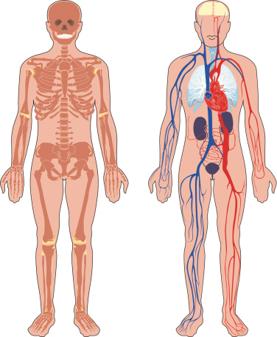
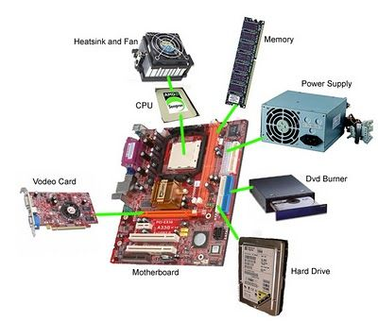
Comparing the Human Body parts to computer parts!
PowerPoint Project
By: Ms. Williams
Technology Teacher

Slide 2
Background of a system unit/Desktop
A System Unit, also know as a “tower” which is the main part of a desktop computer. It includes the motherboard, CPU (Central Processing Unit), RAM (Random-Area-Memory), ROM (Read-Only-Memory), Power supply (Wire), Coolant (FAN), GPU (Graphic Processing Unit), DVD/CD ROM. The motherboard is like the city of the system unit. Compared to the City of Yonkers with all the buildings connected inside it. This is how all the components are connected by using the motherboard. The system unit also includes the casing that houses the internal components of the computer. The desktop also includes other hardware’s which are a mouse, speakers, monitor etc. Students so now I would like for you to think about how the human body parts work together for us throughout the day. Our brain, heart, digestion system, nervous system, mouth, ears, eyes, skeleton system, face, hands, and skin are like a computer. Complete this project and you will be able to understand how a computer is like a human body.

Slide 3
Students Follow the instructions below to complete this project
Students in Slide 4 the computer parts are listed and located in Slide 5 is an example of how each slide should look.
  Type the computer part that matches the body part inside each slide
  Insert an image of the computer part
  Explain the functions of the human part and computer part on each slide
  Find one MAIN word in each function explanation that you typed and highlight the word in yellow.
  Define the words that are highlighted in yellow in the text box below with a short description
  Type your responses on the PowerPoint Presentation
  Go to File Save As: CIS Project Summer Assignment
  Students send this project as an attachment and email to: twilliams4@yonkerspublicschools.org

Slide 4
The Computer is like the Human Body!
The computer parts you are going to match up to the human body are listed below:
System Casing
C.P.U.
Microphone
Monitor
Motherboard
Mouse
Power Supply/ wires
Speakers
Webcam
Memory (RAM)
Hard Drive (ROM)
Fan/Coolant

Slide 5
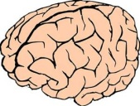
Human Body parts compared to computer parts
EXAMPLE SLIDE
Brain
CPU
(Central Processing Unit)
Explain the Function: the command center for the human nervous system. It receives signals from the body's sensory organs and outputs information to the muscles.
Explain the Function: the electronic connection within a computer that executes instructions that make up a computer program.
Output – produce, deliver, or supply (data) using a computer
Executes - carry out or put into effect

Slide 6
Human Body parts compared to computer parts
Nervous system
Explain the Function:
Explain the Function:

Slide 7
Human Body parts compared to computer parts
mouth
Explain the Function:
Explain the Function:

Slide 8

Human Body parts compared to computer parts
eyes
Explain the Function:
Explain the Function:

Slide 9
Human Body parts compared to computer parts
Brain (multiple functions)
Explain the Function:
Explain the Function:

Slide 10
Human Body parts compared to computer parts
Skin
Explain the Function:
Explain the Function:

Slide 11
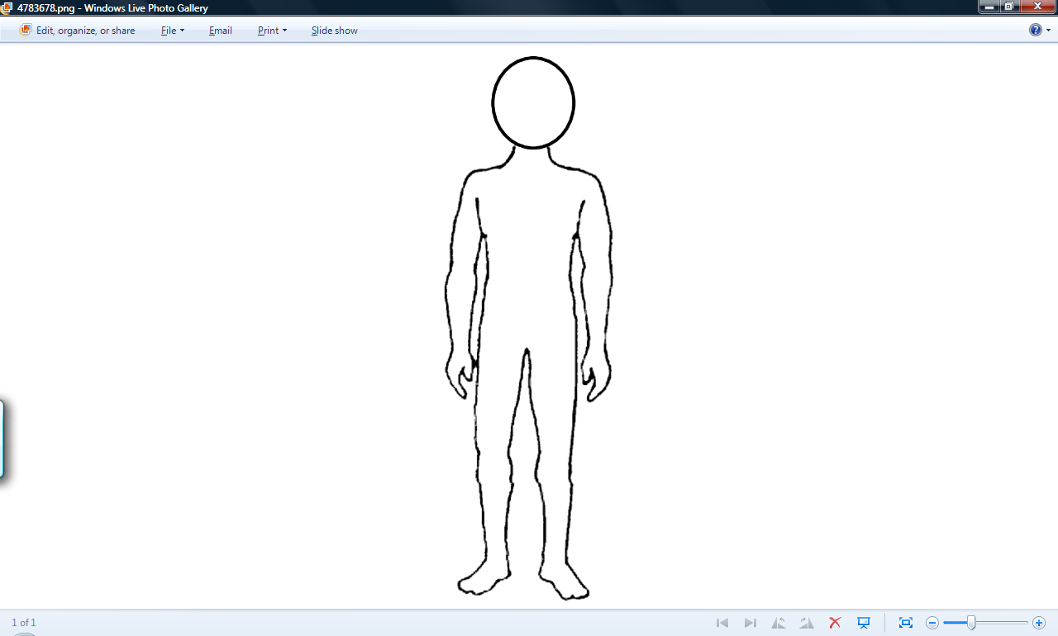



Human Body parts compared to computer parts
face
Explain the Function:
Explain the Function:

Slide 12
Human Body parts compared to computer parts
Hand
Explain the Function:
Explain the Function:

Slide 13
Human Body parts compared to computer parts
Ears
Explain the Function:
Explain the Function:

Slide 14
Human Body parts compared to computer parts
heart
Explain the Function:
Explain the Function:

Slide 15
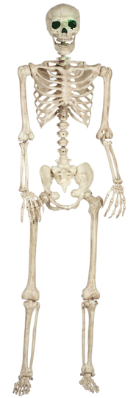
Human Body parts compared to computer parts
skeleton
Explain the Function:
Explain the Function:

Slide 16
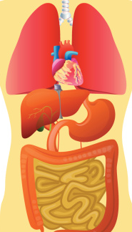
Human Body parts compared to computer parts
Digestion System
(get rid of body waste temporary)
Explain the Function:
Explain the Function:

Slide 17
Human Body parts compared to computer parts
Sweat gland
Explain the Function:
Explain the Function:

Slide 18
memory
ROM (Read-Only-Memory)
RAM(Random access memory)
What is the difference between the two?
Where are they located inside the System Unit?
Which one can you use to speed up the CPU (Central Processing Unit)?
Why are both computers parts important inside a System Unit?
Keyboard
What body part can be compared to the computer part listed above? Remember this is an input device. Type your response HERE: ______________________

